Slide 1
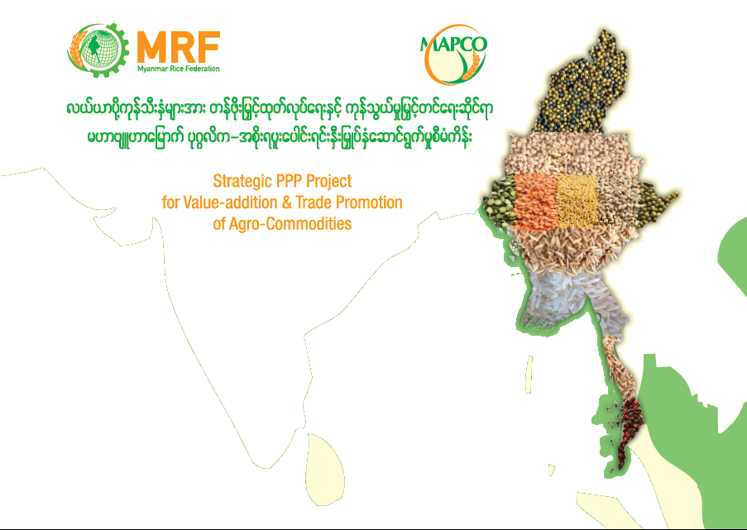
Ye Min Aung
Secretary-General
Myanmar Rice Federation
March 18, 2016
Seminar on the Role of Private Rice Sector & Seed Industry, organized by Department of Agriculture

Slide 2


Slide 3

SIGNIFICANT REFORMS & DEVELOPMENT
EVENT | YEAR
Formation of Rice Specialization Companies (RSC) Privatization of State-owned rice mills/warehouses | 2009
Formation of Myanmar Rice Federation (formerly Myanmar Rice Industry Association, MRIA) | 2010
Formation of National Reserved Stockpile Program (Food Security) | 2011
Enactment of Farm Land Law Formation of the Myanmar Agribusiness Public Corporation (MAPCO) | 2012
Foreign Investment in Agriculture & Rice Sector Enactment of Farmers’ Rights Protection & Empowerment Law EU’s GSP EBA Program High Quality 5% Rice Export to Japan by MAPCO-Mitsui in 45 years | 2013
Parboiling Facilities (300,000 MT annual production capacity) Modern Rice Mills High Quality 5% Rice Export to Japan by MAPCO-Mitsui (second time) | 2014
Regional Farmers Development Bank SPS Protocol finalized with China AQSIQ, first official export by MAPCO-COFCO | 2015

Slide 4
MRF Focus Areas
Implementing Teams/ Stakeholders and Expert Working Groups (SEWGs) being formed for
  Development of Seed Industry
  Development of Processing & Storage
  Continual Growth of Paddy & Rice Trade
  Farm Mechanization Services
  Companies & SMEs development
  Trade Financing & Financial Matters
  Sustainable Rice Sector Development Programs

Slide 5
Enabling Legal & Regulatory Framework
– Key Recommendations
Review, Modification & Enforcement on the following laws:
(i) Farmland Law, other related Land Laws & Promulgation of New Land Law which can override all the Land Laws
(ii) Farmers’ Rights Protection & Empowerment Law
(iii) Myanmar Agricultural & Rural Development Bank Law
(iv) Essential Goods & Services Law, Export & Import Law
Introducing the Standard Operating Procedures, Monitoring & Supervisory Procedures on Contract Farming
Legal and regulatory matters related to Crop Insurance
Legal and regulatory matters on Farmers Development & Regional Development Bank Rule issued by Central Bank

Slide 6
Institutional development
Empowering & supporting the Agricultural Specialization Companies, most of which were established in 2009-2010, financing their strategic projects which can generate positive impact, incentivizing them so that they can play a crucial force
Introducing State Agricultural Marketing Board under private-public partnership
Effective & Efficient Private-Public Dialogue and Partnership
Strengthening and enhancing the workforce, in both quality and quantity, at Department of Agriculture, Department of Agriculture Research in order to increase, enhance Seed Breeding & Multiplication, Extension/Crop Protection & Advisory services to farmers

Slide 7
Policy & Strategy
MRF’s key activities involve Recommendation, Advocacy, Analysis of national rice policies and strategies.
- Identifying and understanding the weaknesses
- Improving and sustaining the strengths
- Coordinated reform and transformation of rice industry
- Attracting FDI – more than just trading
- Capacity enhancement & support to Private Sector
- Taking advantage of New Markets Preferential Treatments
SME Development & Promotion of National Competitiveness

Slide 8
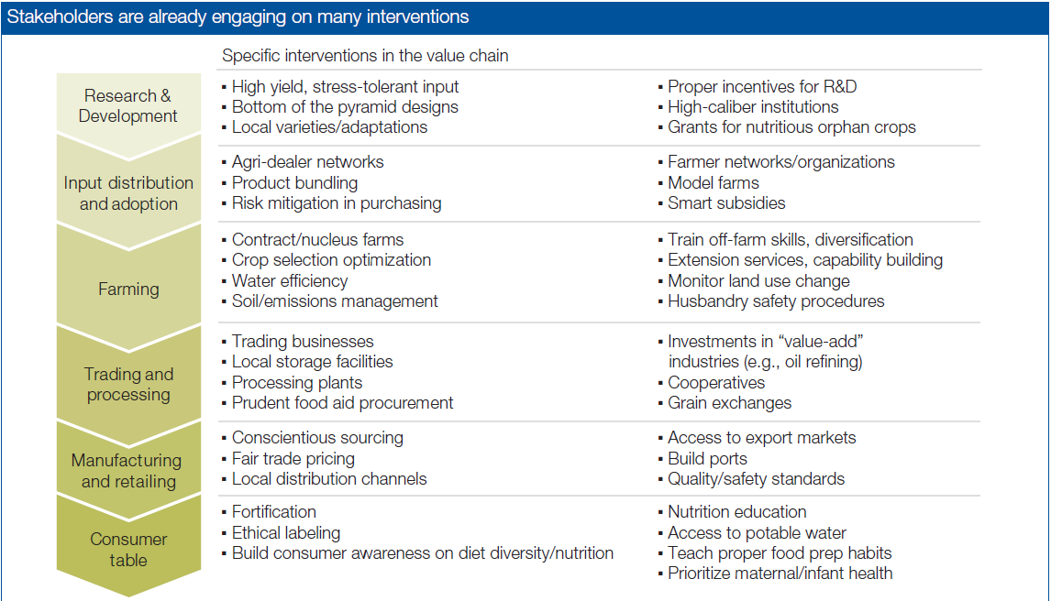
Key Red Circle Areas need more intervention

Slide 9
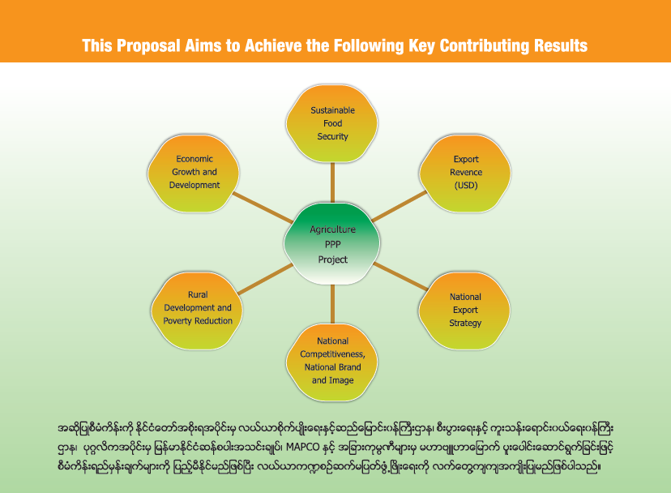

Slide 10


Slide 11
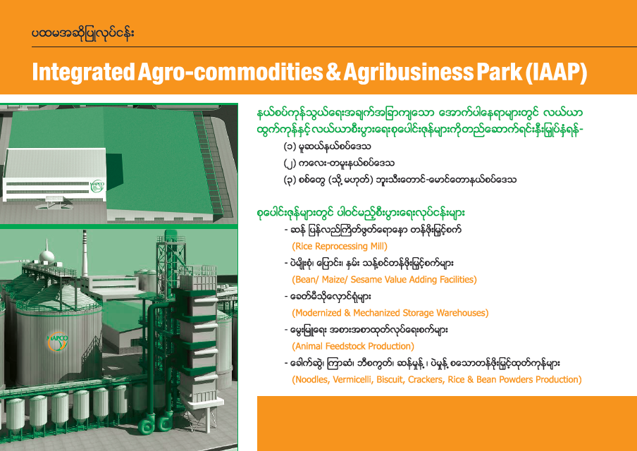

Slide 12
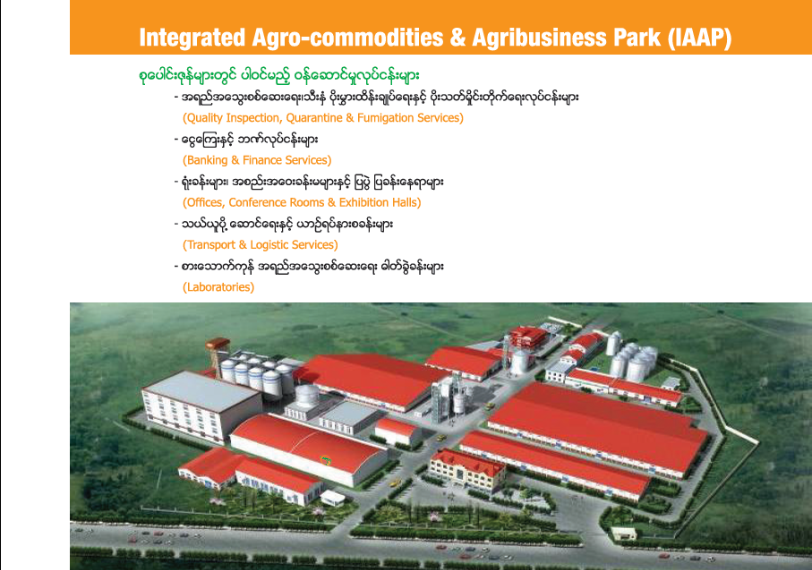

Slide 13
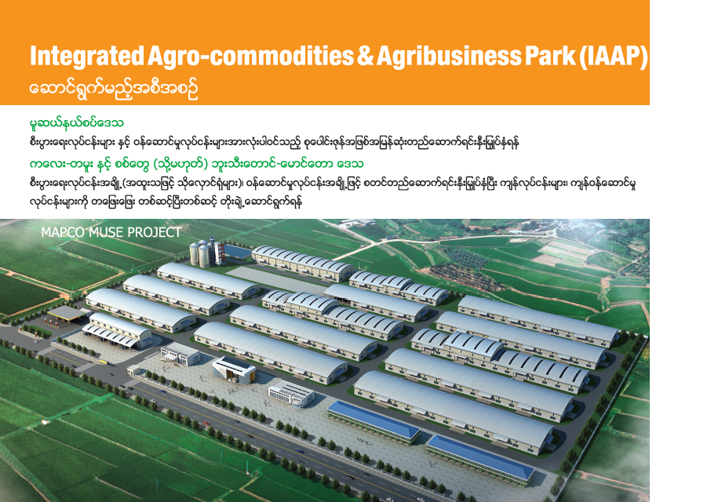

Slide 14
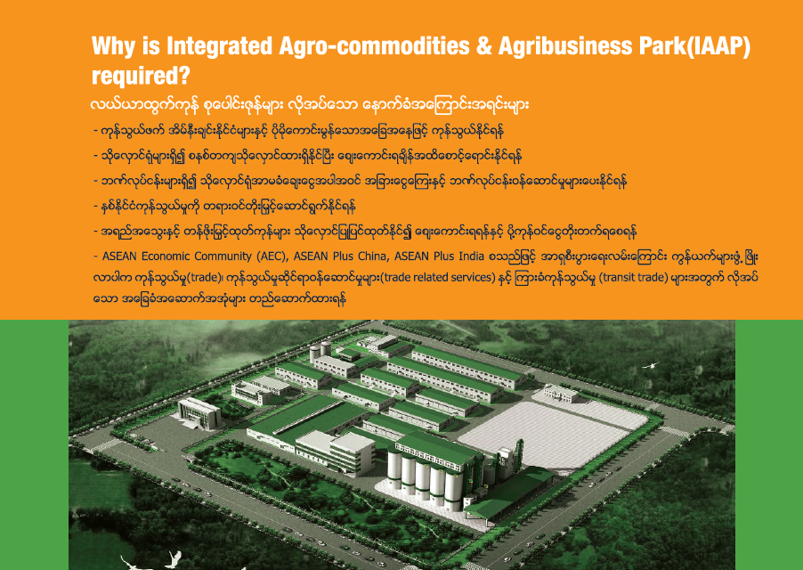

Slide 15
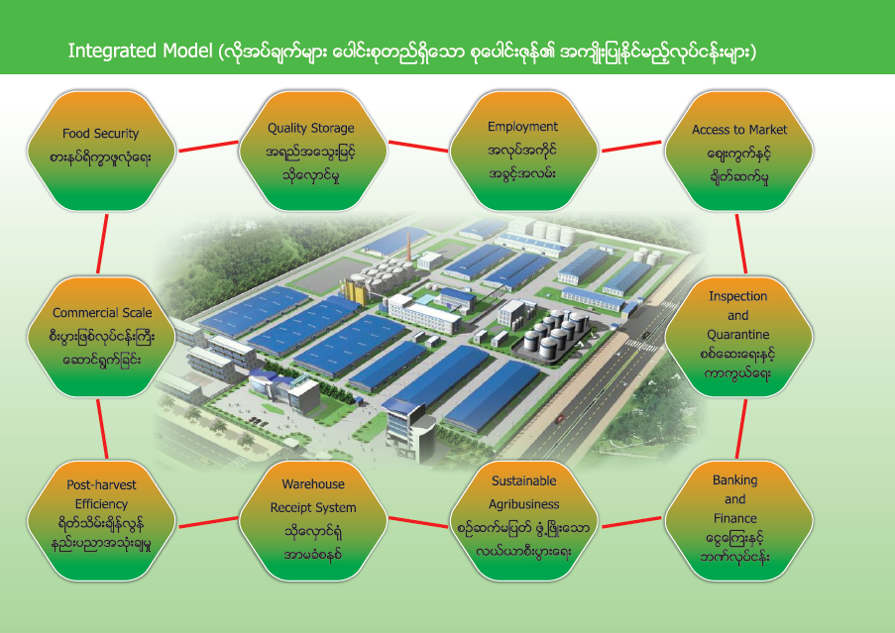

Slide 16
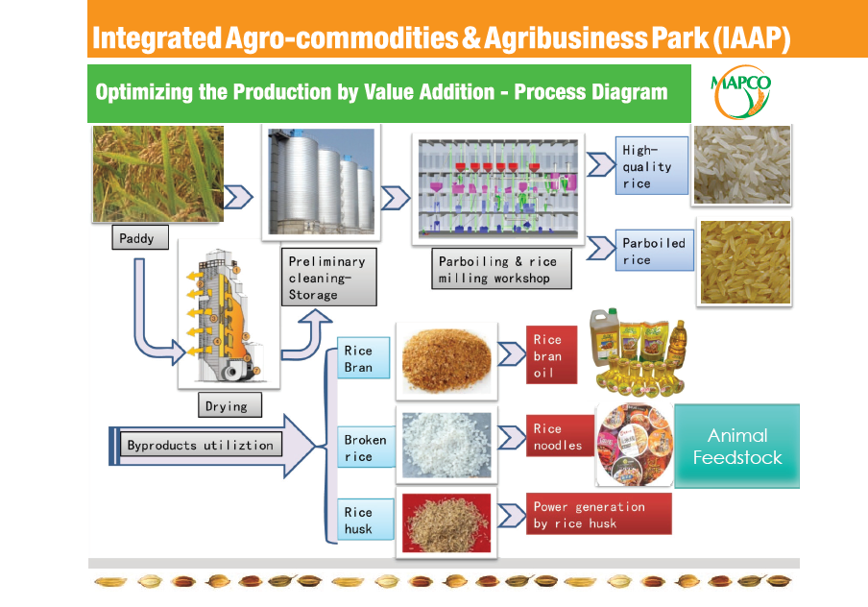

Slide 17
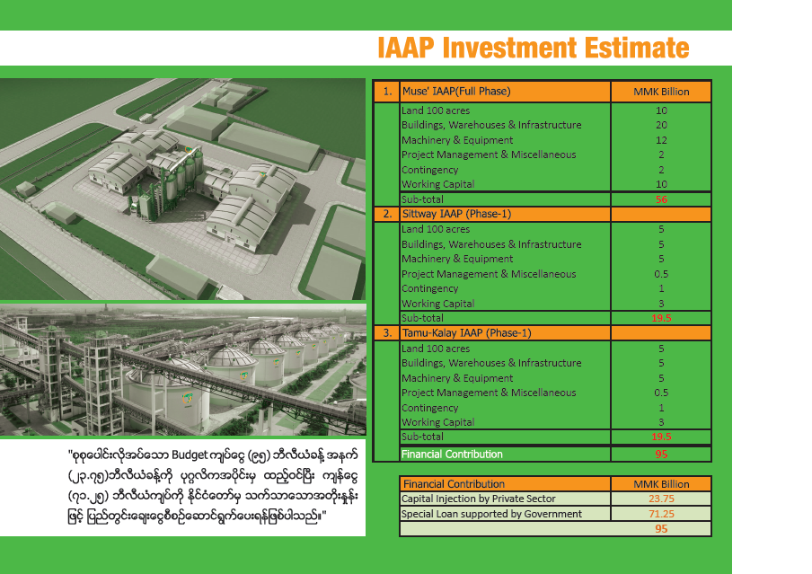

Slide 18
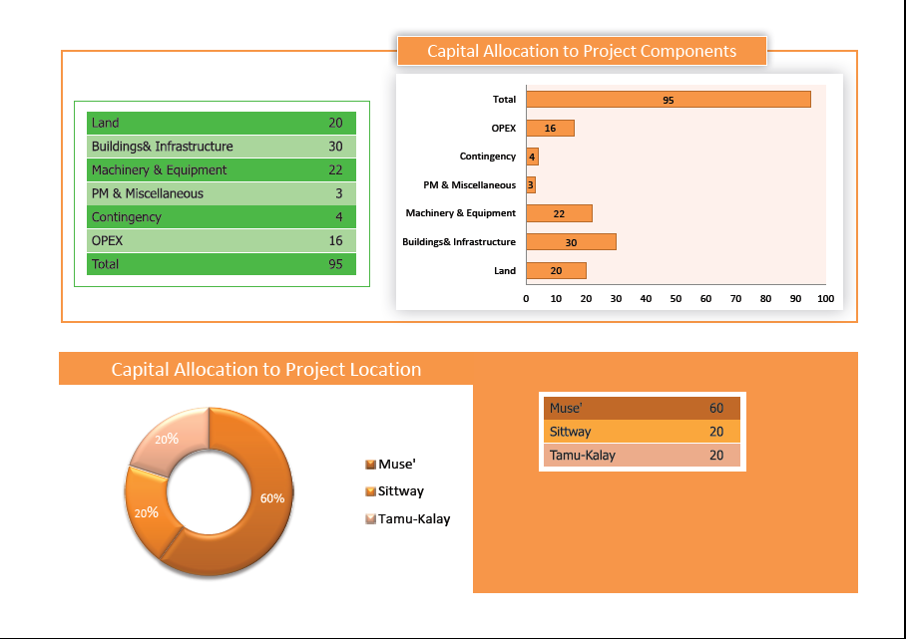

Slide 19
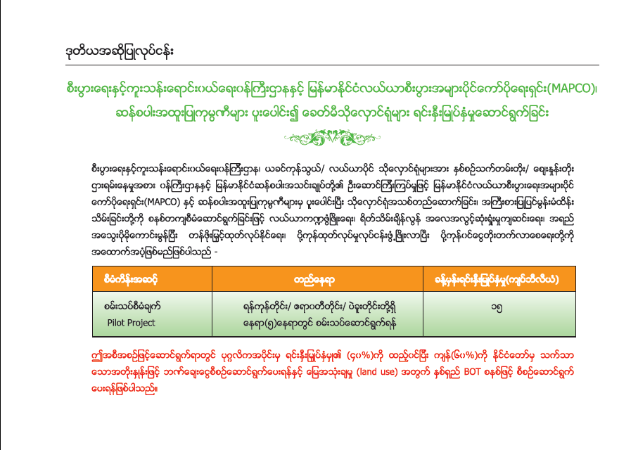

Slide 20


Slide 21
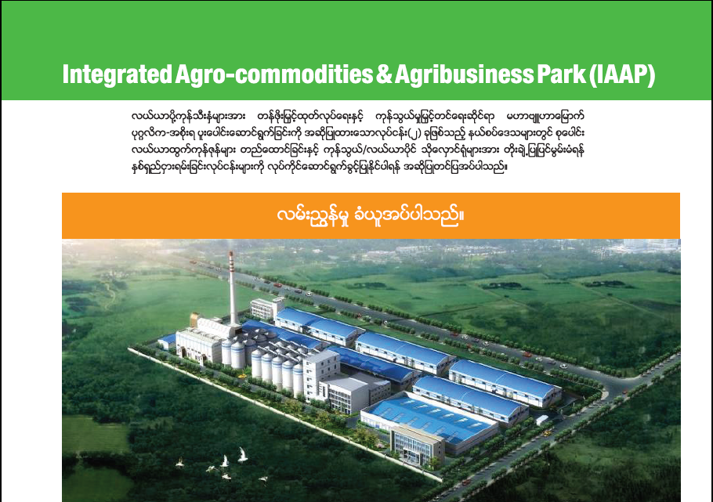
Public-Private Partnership Projects for Rice Sector Development

Slide 22


